Slide 1

Optimizing Plywood Business Operations Using Data Analytics
Business Data Management Project Presentation
Punit Kumar 23F1002051 Jan 2025 Term

Slide 2
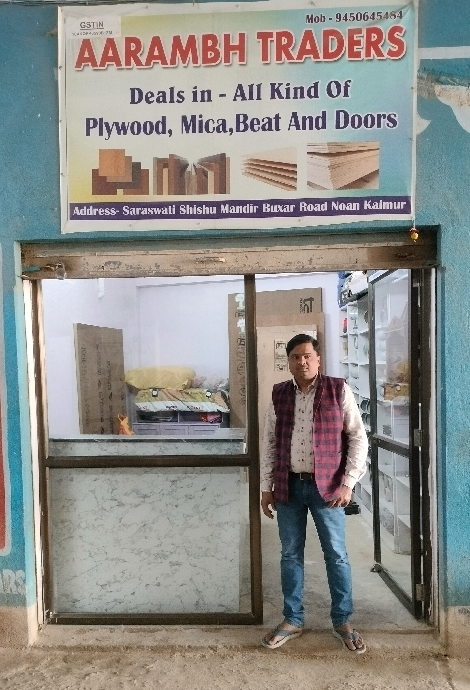
Organization Background
Aarambh Traders is a local plywood supplier dealing in a variety of plywood products.
The business caters to both retail and wholesale customers, offering plywood used in furniture, construction, and interior work.
It maintains daily records of sales, purchases, and customer credit manually using a register.
Owner Name : Manish Kumar
Location : Nuaon, Kaimur, Bihar
Industry : Plywood Distribution and Trading
BDM Project Presentation

Slide 3
Problem Statements
Problem 1​
Problem 2
Problem 3
Inventory Management Issues :
Difficulty in tracking stock levels manually leads to overstocking of some SKUs and shortages of others, affecting timely customer service and increasing holding costs.
Profitability Tracking Challenges:
Lack of systematic analysis of cost price vs. selling price makes it hard to assess profit margins per product, and calculate gross profit timely to maintain ensure profitability.
Customer Credit and Payment Delays:
Manual credit tracking results in delayed payments and poor cash flow visibility, making it difficult to follow up with customers and manage financial stability effectively.

Slide 4





Data Collection and Methodology
Primary Data Source
Data was collected directly from Aarambh Traders through visits and discussions with the business owner.
Manual Records
Information was extracted from handwritten registers where daily transactions were recorded.
Data Entry
All the data was digitized and organized using Microsoft Excel for further analysis.
Data Cleaning & Structuring
Ensured consistency in date formats, customer names, and SKU naming.
Removed duplicate entries and corrected manual errors during digitization.
Tools Used
Microsoft Excel, Pivot Tables, Conditional Formatting, Charts and Graphs
4

Slide 5
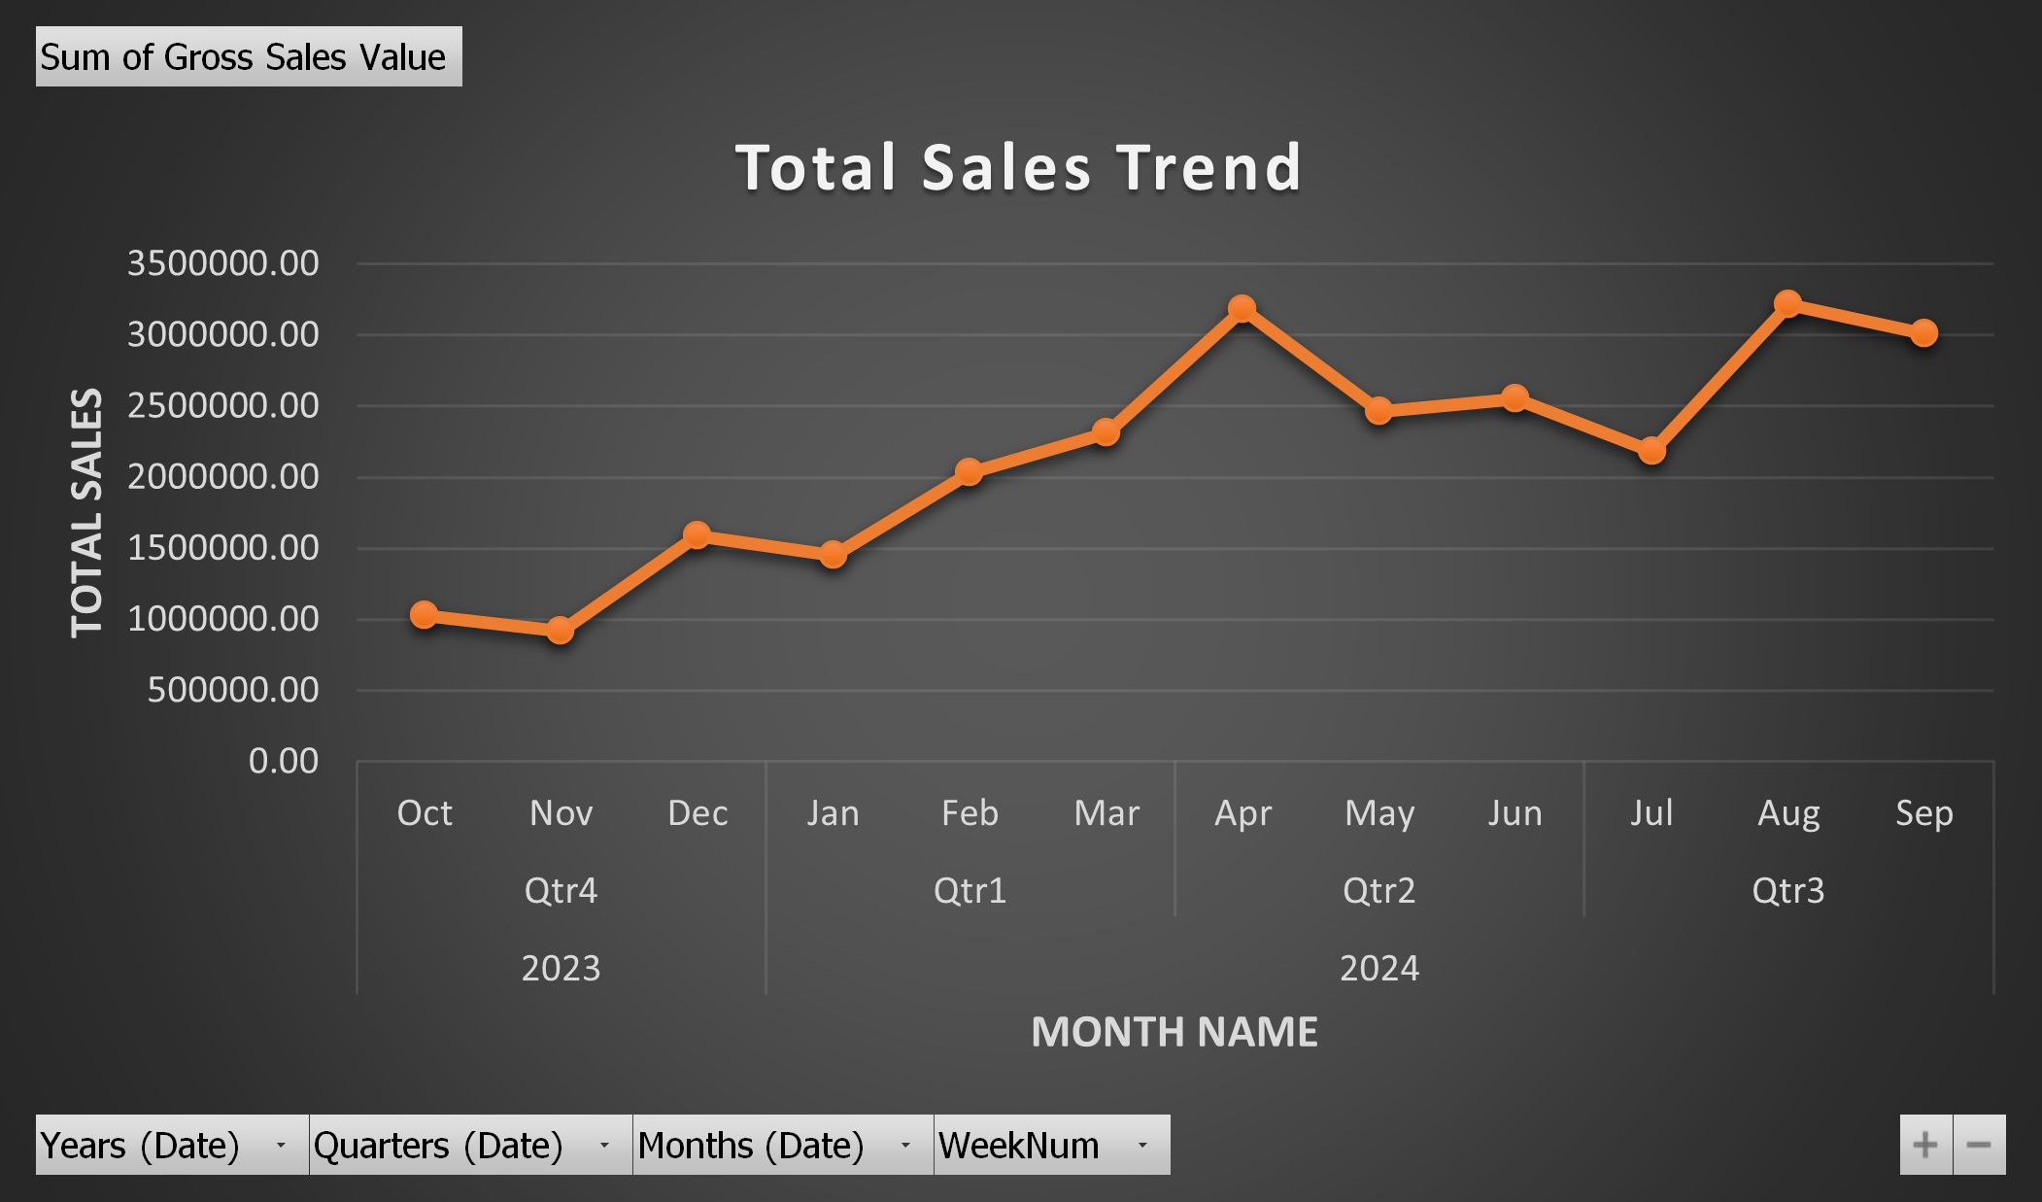
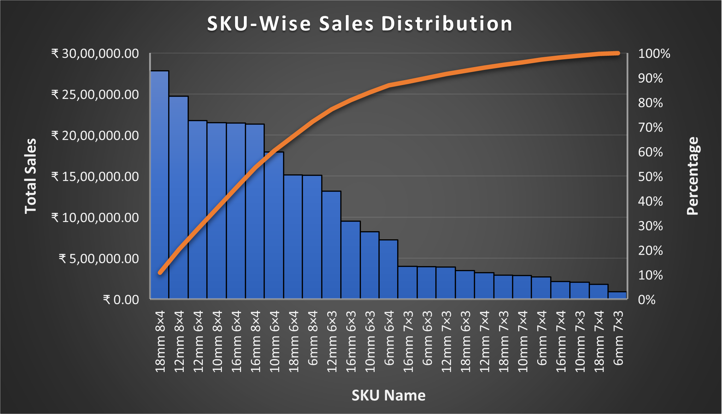
4. Results and Findings
Sales Analysis
Sales peaked in April with strong Q1 growth, driven by the owner’s business expansion to new areas.
Dip in June–July was due to decreased seasonal demand.
August saw a spike in sales again, attributed to the wedding season.
Few SKUs (e.g., 18mm 8x4, 12mm 8x4) contribute the majority of total sales.
Around 20% of SKUs contribute nearly 80% of sales, indicating a classic Pareto (80/20) rule pattern.
Many SKUs have low sales, indicating possible overstock.

Slide 6
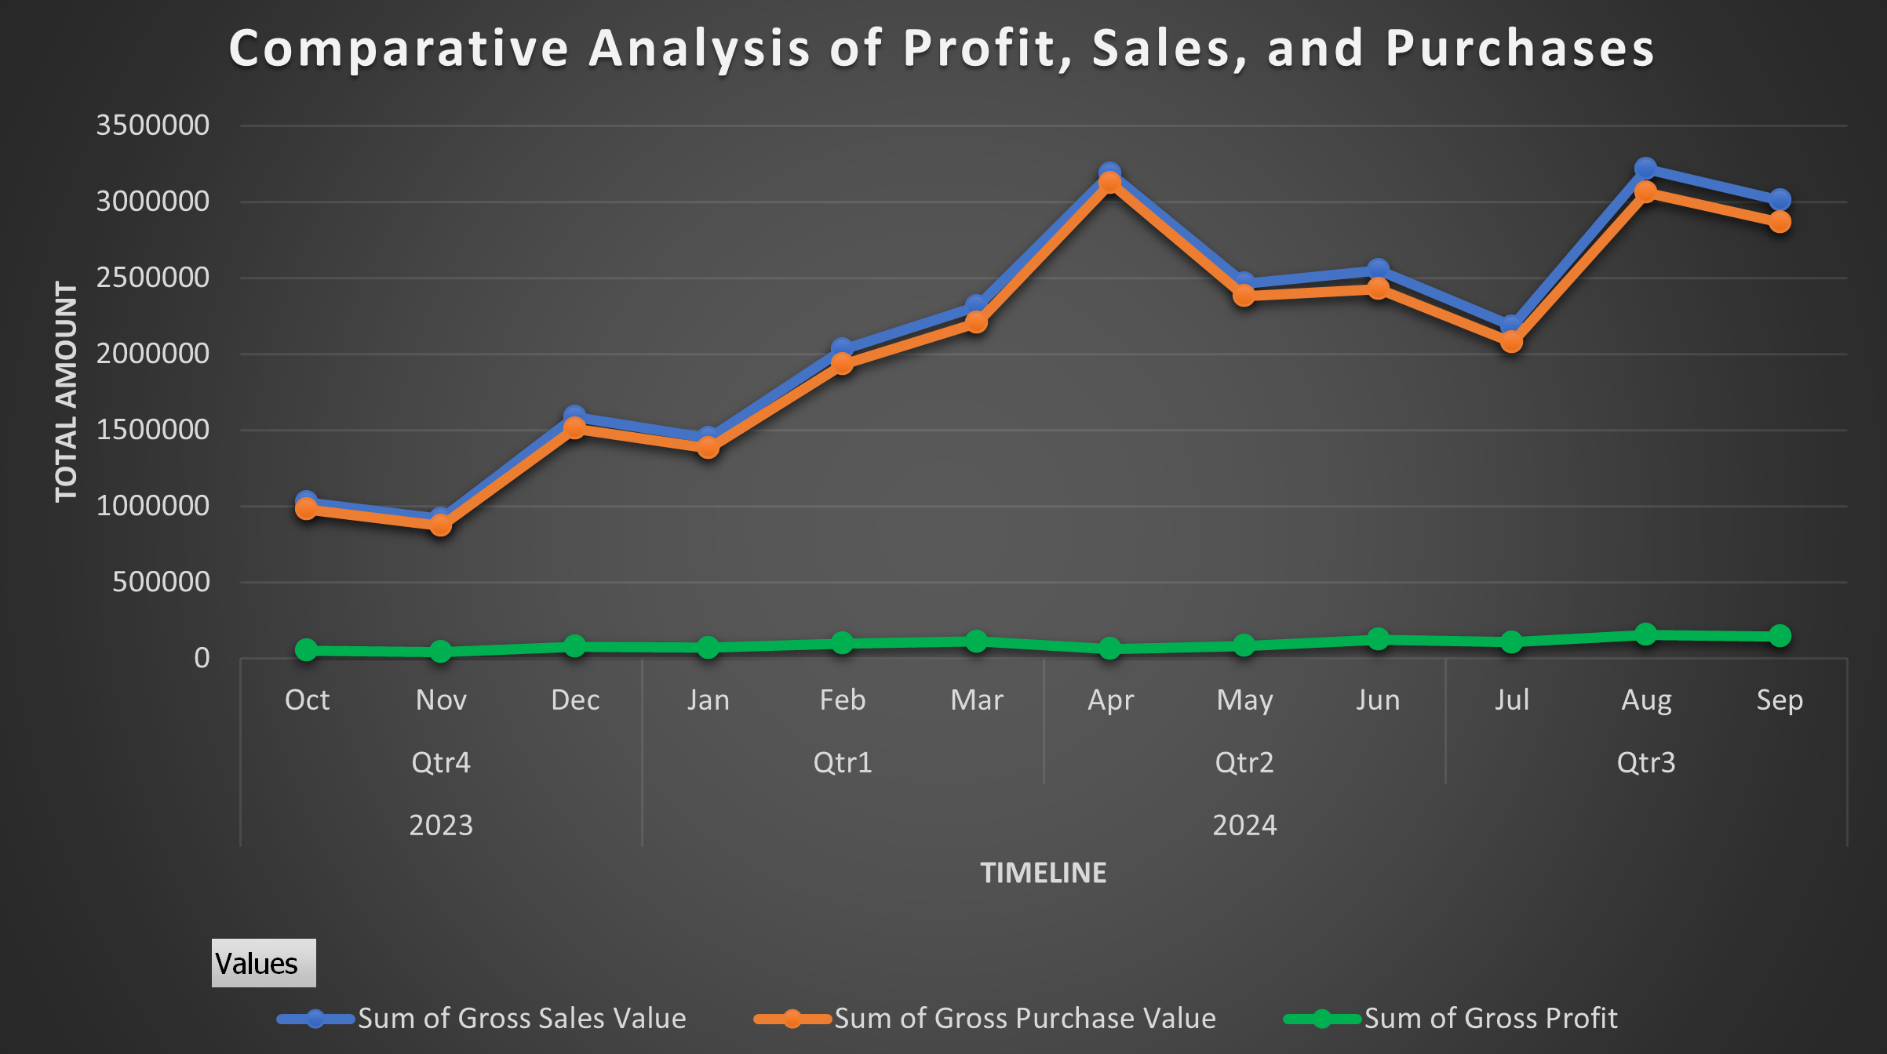
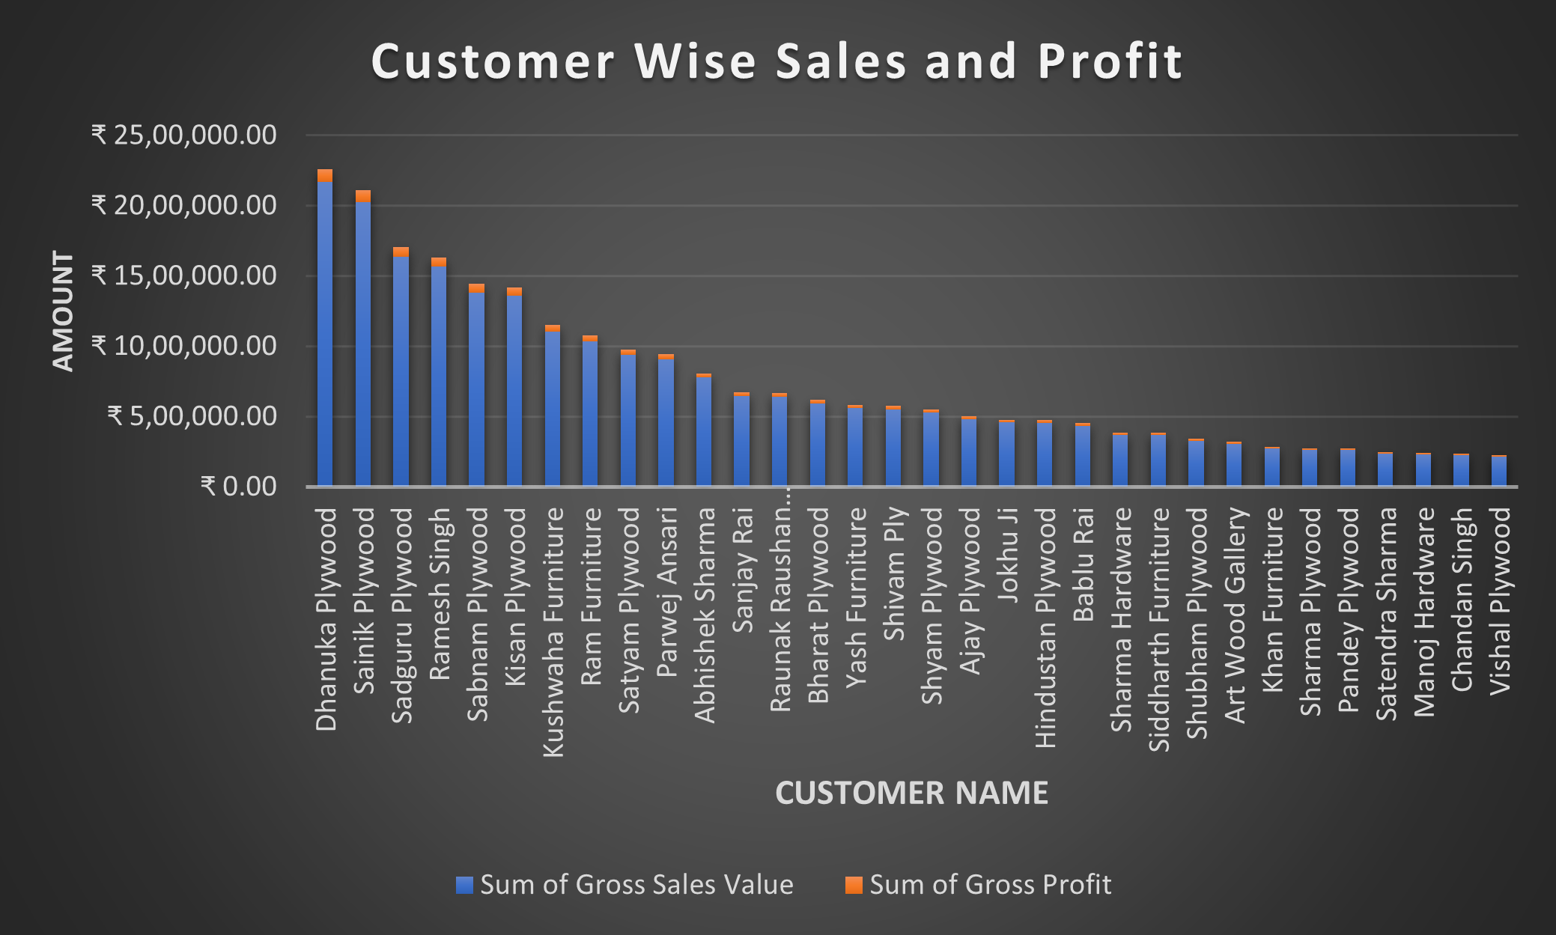
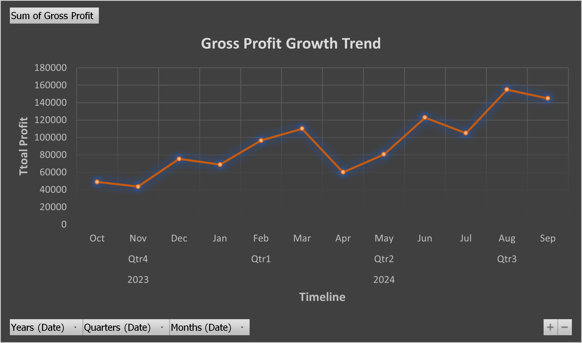
Profit Analysis
The chart reveals a classic client concentration pattern, where the top 5 customers account for a major chunk of revenue and profit.
There's a noticeable drop-off after the top 10 customers, reinforcing the client concentration risk.
From October to March, the business showed steady growth in both sales and profit.
April had high sales but low profit margin—because of increasing purchase cost.
After that August and September also get peaked in sales and profit due to wedding season.

Slide 7
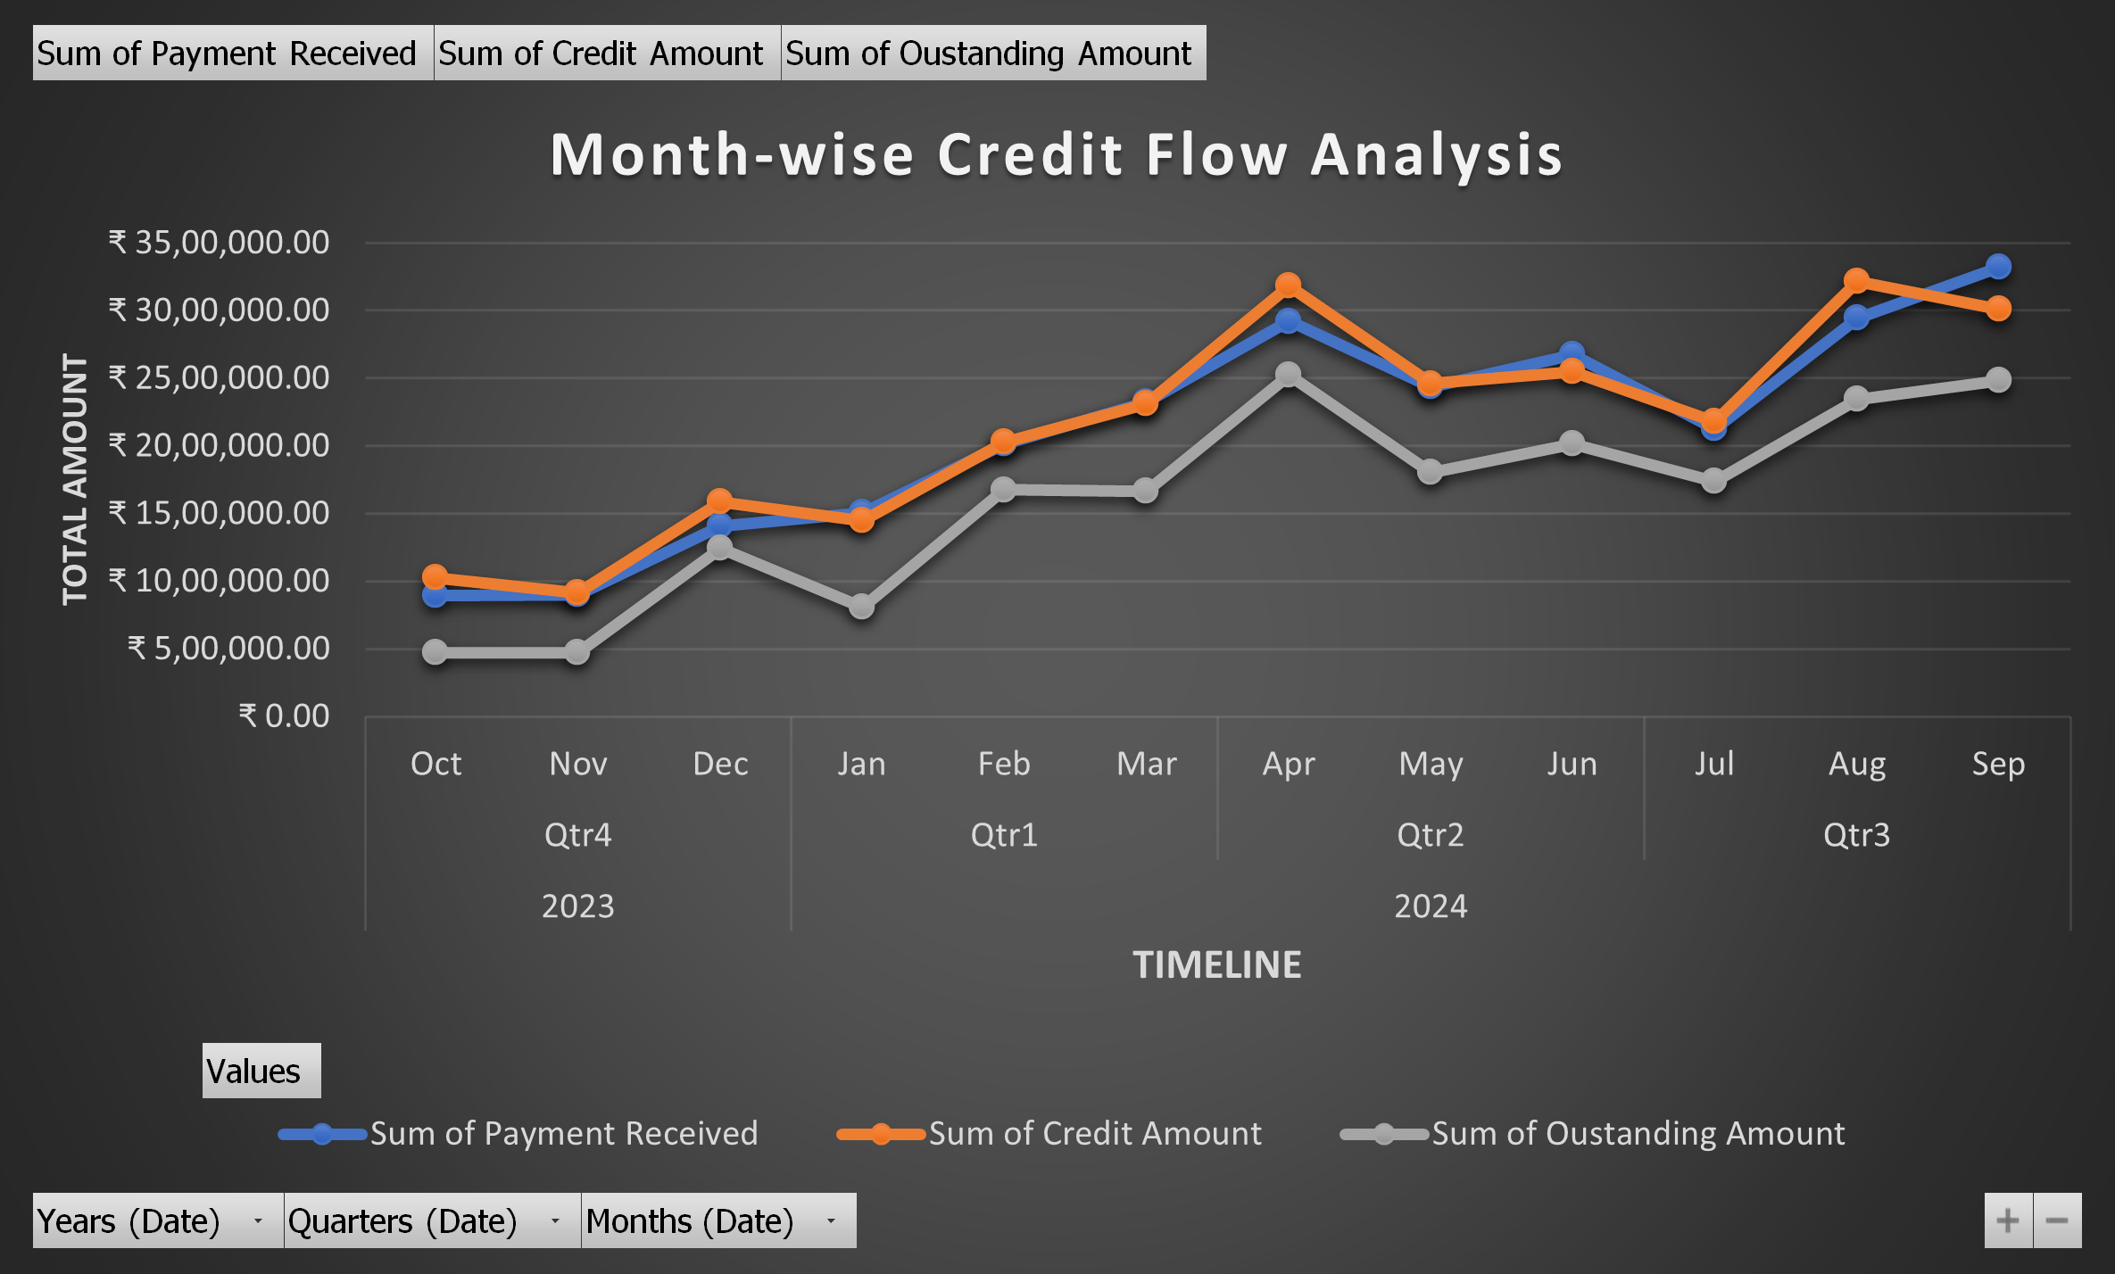
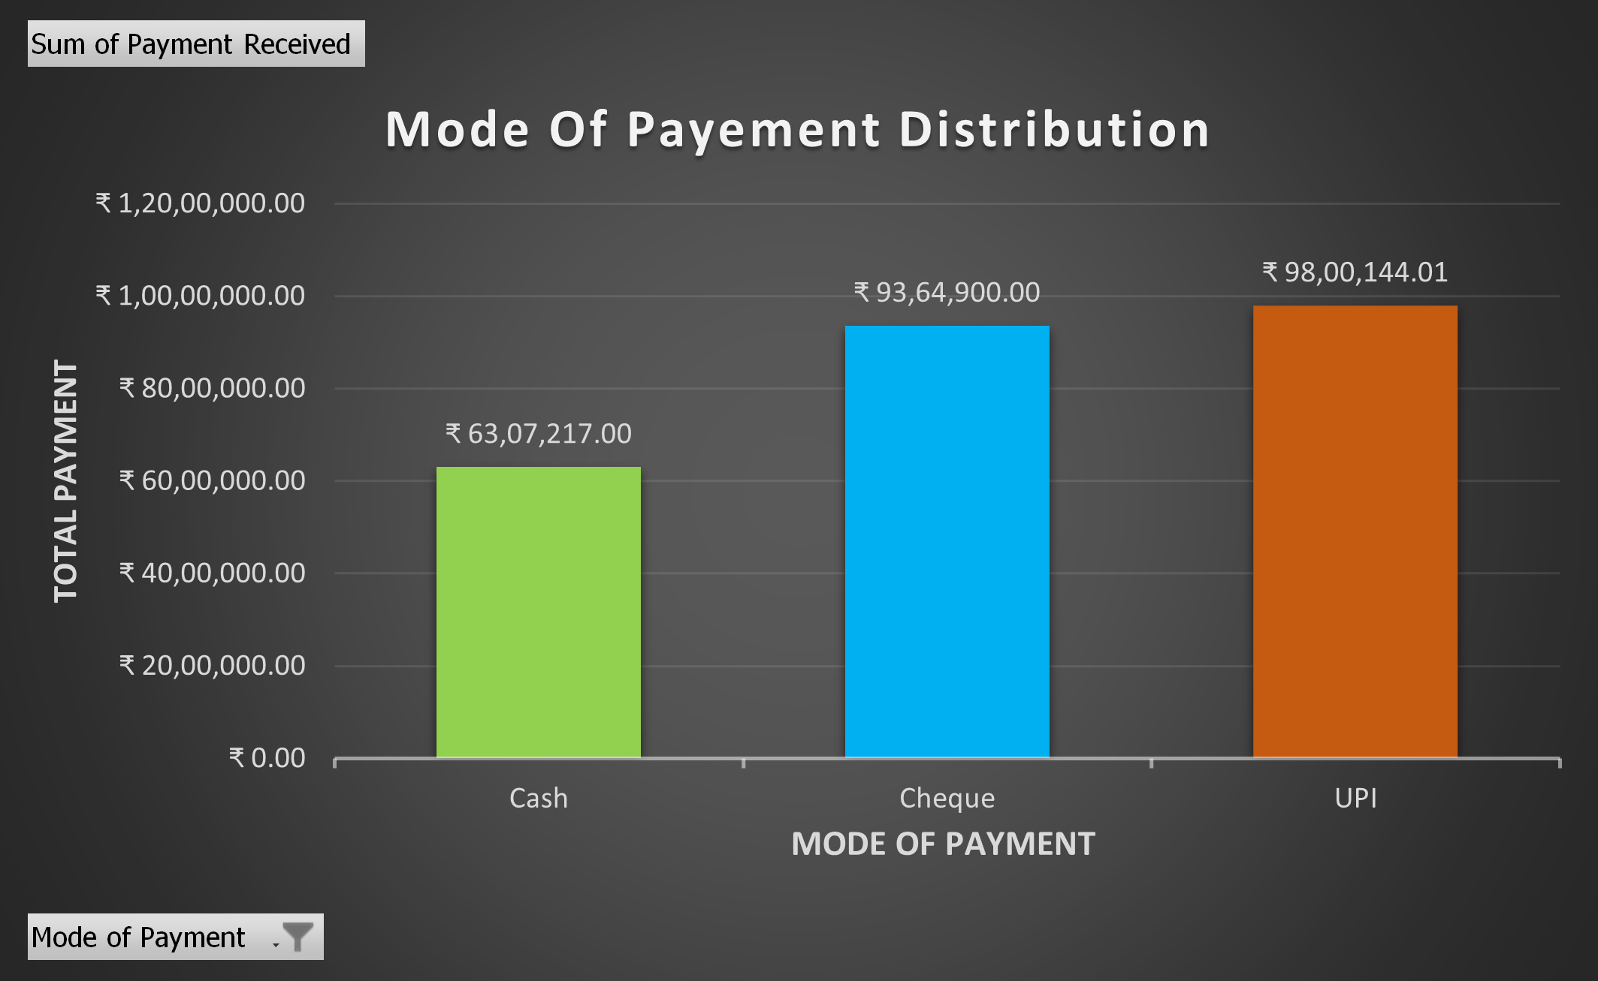
Credit Analysis
Mode Of Payment | Average of Payment Received
Cheque | ₹ 91812.75
UPI | ₹ 27762.45
Cash | ₹ 16730.02
Over time, the business gave more credit and got more payments, the total amount people owed the business also increased.
Lots of credit and payment done in April because of business expansion in new location.
In September, Payment received surpasses the credit amount but outstanding amount doesnot decrease as much because of older outstanding amount.
UPI and Cheque transactions have nearly equal total transaction values, as seen in the graph.
UPI = high frequency, low amount
Cheque = low frequency, high amount.
Cash is the least popular mode of payment among the three shown, with a total payment of ₹63,07,217.00 and average payment of 16730.

Slide 8
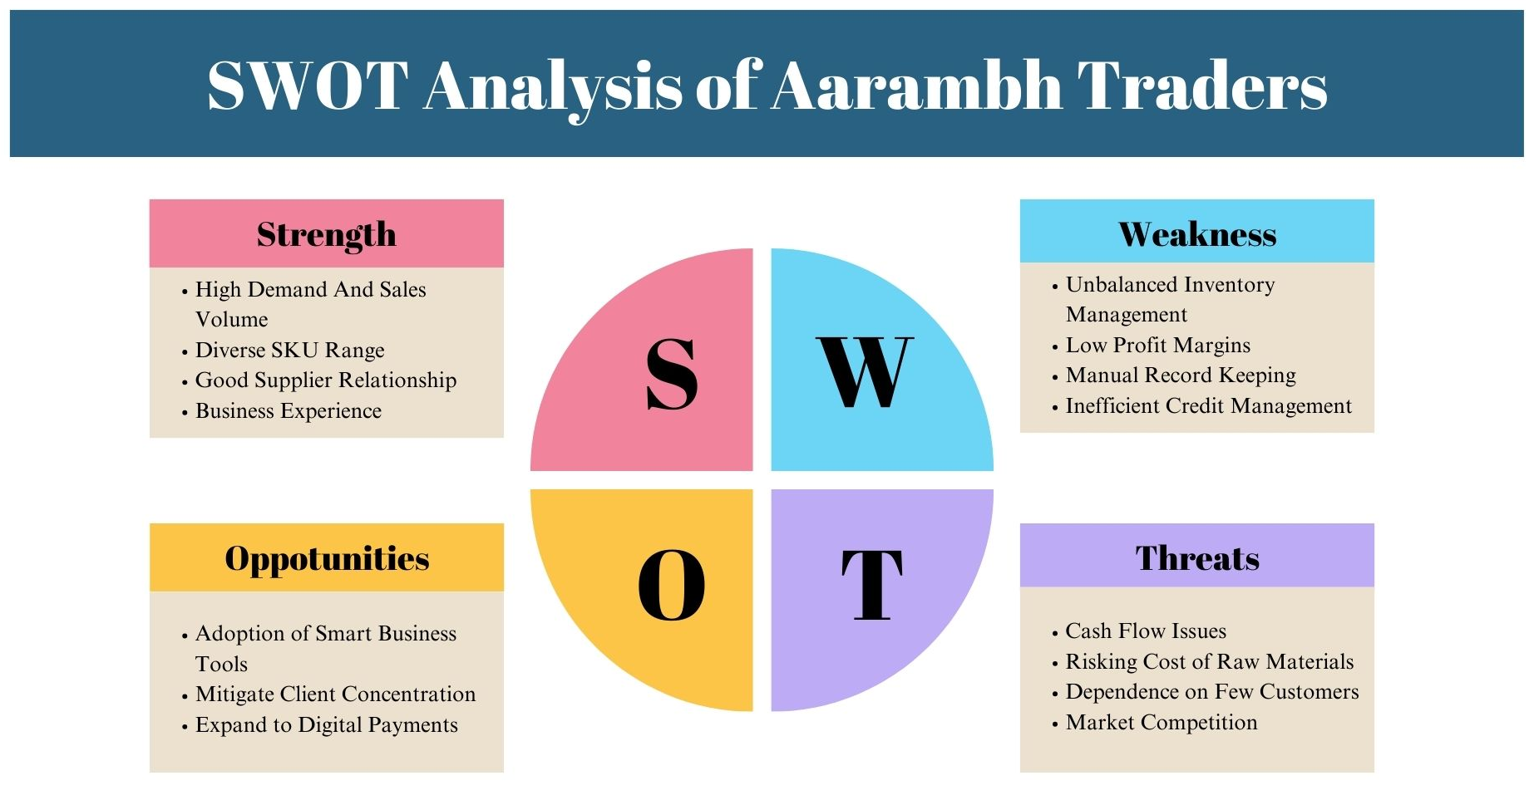

Slide 9
Interpretation
Inventory Analysis
Overstocking of Multiple Stock
Stockout in High Demand SKU
No Seasonal Stock Planning
Profit Analysis:
Small group of SKUs contribute majority to profits.
Not Tracking Profit Timely
Manual Errors in Profit Management
Credit Analysis:
High Outstanding from few Customers
Payment Delays
No Credit Limit Policy
Recommendation:
Dynamic Reordering
Seasonal Stock Planning
Focus on Fast Moving SKUs
Adopt JIT for slow moving SKU
Recommendation:
Focus on High Margin SKUs
Timely Profit tracking
Use software for profit calculation
Recommendation:
Define Credit Limit per Customer
Send timely reminders
Restrict credit to defaulters

Slide 10
Recommendations
Dynamic Reordering:
Use monthly demand and seasonal index to set accurate reorder levels for each SKU.
For solve Credit Problems:
Encourage Advance Payment
Send payment reminders
Define Credit Limits
Timely Profit Calculation :
Use excel or business software to calculate effective profit margin over time.
Diversify Customer Base:
Reduce client concentration risk by targeting new customers and industries to ensure stable and consistent revenue flow.
Adoption of Smart Business Tools:
It solves inventory issue, profit management, payment delays

